Slide 1
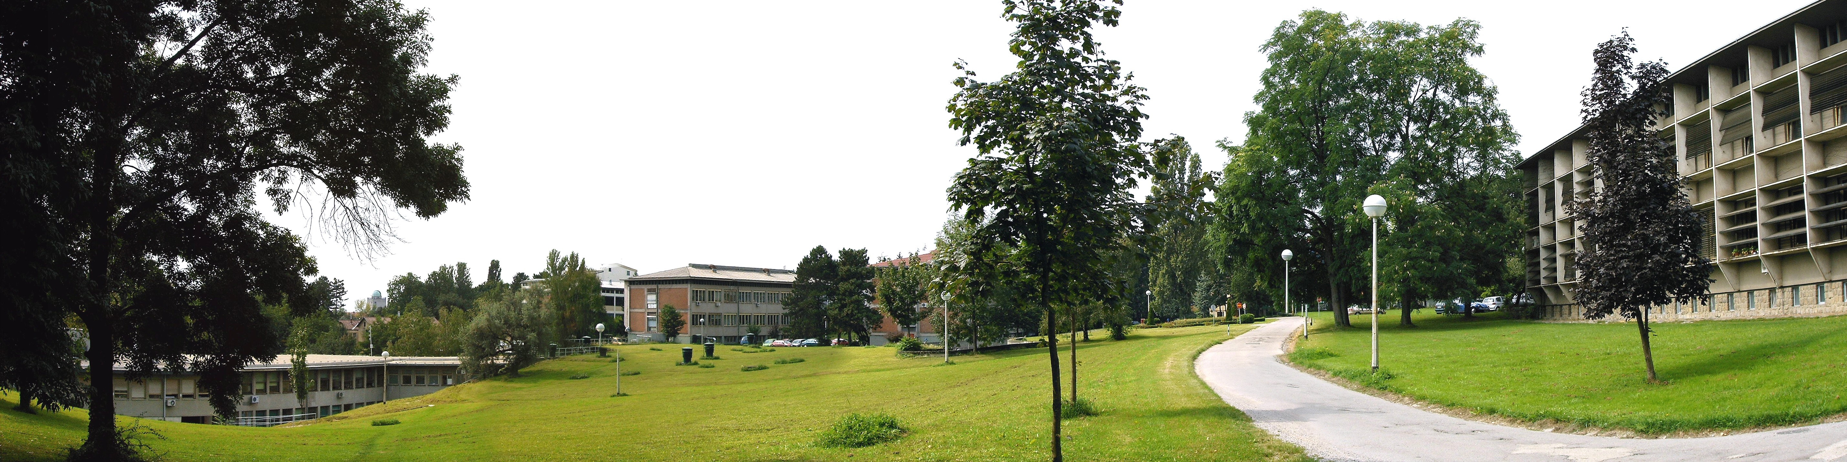

RBI IS THE LARGEST MULTIDISCIPLINARY
RESEARCH INSTITUTE IN CROATIA
130,000 M² AREA
850 EMPLOYEES
OVER 450 PhDs

Slide 2





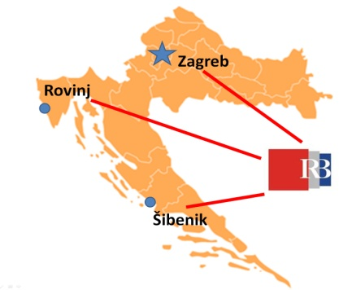
PHYSICS
CHEMISTRY
LIFE SCIENCES
ENVIRONMENT
COMPUTER SCIENCE
THEORETICAL PHYSICS | MATERIAL CHEMISTRY | MOLECULAR MEDICINE | MARINE & ENVIROMENT | ELECTRONICS
MATERIAL PHYSICS | ORGANIC CHEM. & BIOCHEMISTRY | MOLECULAR BIOLOGY | CENTER FOR MARINE RESEARCH | eSCIENCE
EXPERIMENTAL PHYSICS | PHYSICAL CHEM.
 | NMR
Mission:
Excellent science
Strong involvement in higher education
Leading contribution to the growth of the national economy
80 research laboratories
11 research divisions
3 support centres
Notes:
Izvor IRB Ured za projekte i međunarodnu suradnju

Slide 3
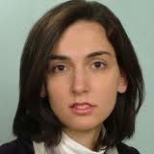

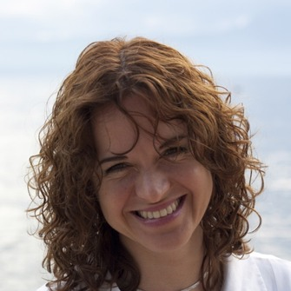
ERC at RBI – 2 of 5 in Croatia, both returnees
MEMBRANES ACT / Ana Suncana Smith: Biological Membranes in Action: A Unified Approach to Complexation, Scaffolding and Active Transport
NewSpindleForce / Iva Tolic: A new class of microtubules in the spindle exerting forces on kinetochores
Notes:
Izvor IRB Ured za projekte i međunarodnu suradnju

Slide 4





Centers of Excellence
PaRaDeSec: Expanding Potential in Particle and Radiation Detectors, Sensors and Electronics in Croatia (RBI)
CEMS: Centre of Excellence for Advanced Materials and Sensing Devices (RBI + IF)
BioProCro: Centre of Excellence for Marine Bioprospecting (RBI + Zg, Rijeka, Split, Osijek)
Notes:
Izvor IRB Ured za projekte i međunarodnu suradnju

Slide 5




Research, Development and Innovation
ApliMetaFarma: High-throughput discovery of application targets in the pharmaceutical industry
Cedevita Healthy OTG: The development of a new, healthier, low calorie, instant vitamin drink
Genom-IGT: Integrated test for the identification of genetic changes that cause infertility
Solar-Module: Advancing solar cells and modules through research and development
Notes:
Izvor IRB Ured za projekte i međunarodnu suradnju

Slide 6
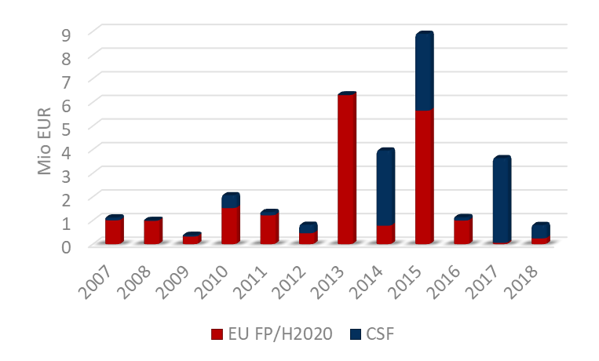
RBI - Performance
2 ERC grants
2 CENTRES OF EXCELLENCE
1 ERA-Chairs Grant
Percentage in Croatia
H2020 projects: Most succesful in Croatia
Currently 17 projects (7.3 M EUR)

Slide 7
Specialized Education
91 Postdoctoral Fellows
121 PhD students
40 – 70 Completed PhDs / year

Slide 8

STRATEGIC INTERNAL REFORMS
2015
STRUCTURAL FUNDS
NEW STATUTE
Encouraging applications to Horizon2020 and other international projects
ORGANIZATION
EVALUATION/
RESTRUCTURING
OF LABS AND DIVISIONS
FACILITY
Encouraging cooperation with industry: patents, leadership positions
Digitalization of internal procedures,
Simplification of administrative procedures
EQUIPMENTT
LABS
Open Infrastructure, flexibility of space and structure
Mobility and new staff/ brain gain focus
ADVANCEMENT
International excellence criteria for hiring and
advancement
INTELECTUAL PROPERTY
International projects criteria for getting leadership positions

Slide 9
Organizational Reforms
Notes:
Izvor IRB Ured za projekte i međunarodnu suradnju

Slide 10
Centre for Detectors, Sensors and Electronics
Scientific Council: Nomination of the evaluation committee (19/06/2018).
Evaluation Committee: Positive evaluation, suggestions for sustainability (09/07/2018).
Scientific Council: Positive evaluation (17/07/2018).
Director: Suggestion to form CDSE, on the basis of the previous evaluations and supporting argumentation from the PaRaDeSec team (08/08/2018).
Management Board: Positive Decision to form CDSE (09/08/2018). Will enter into force following approval from Ministry of Science and Education (very soon).
Notes:
Izvor IRB Ured za projekte i međunarodnu suradnju

Slide 11

Tasks: Present and near future:
Sustained focus on excellence and project success
Increase cooperation with the industry
Brain gain
Strategic scientific and industrial partners outside Croatia
Structural investments/funds

Slide 12
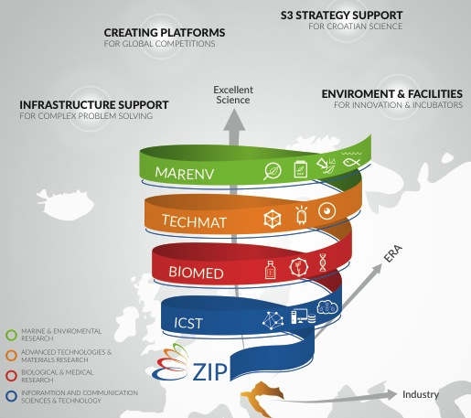
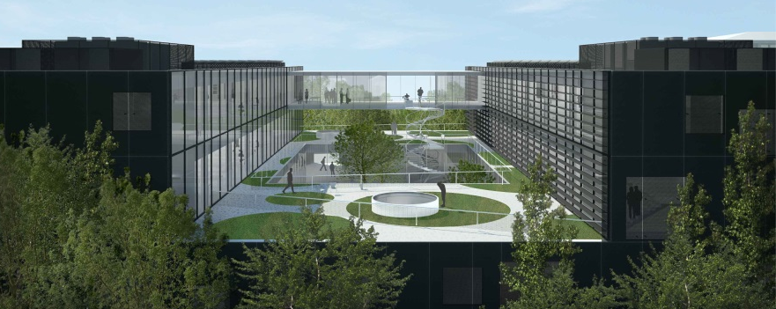
OPEN SCIENTIFIC INFRASTRUCTURAL PLATFORMS FOR INNOVATIVE APPLICATIONS IN THE ECONOMY AND SOCIETY: O-ZIP
Strategic Structural Funds Project
HR Operational Programme 2014-2020
Smart Specialisation Strategy
60 million Euro
2019

